Slide 1
Appointment management system
BY:
Abdul Wasay Usmani
Mehak Mohammad

Slide 2
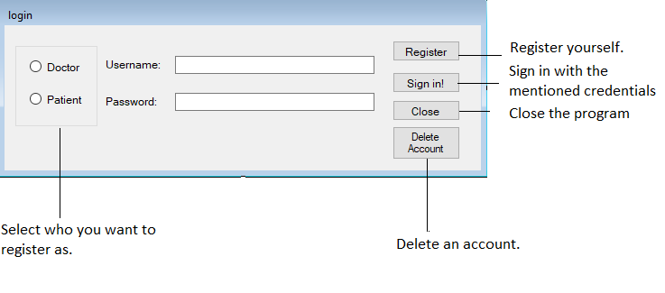
Login page

Slide 3
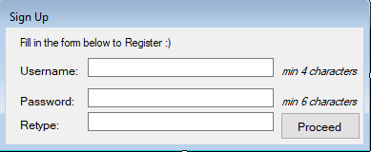
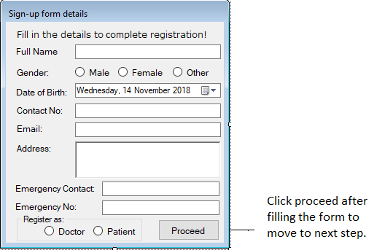
Register Yourself

Slide 4
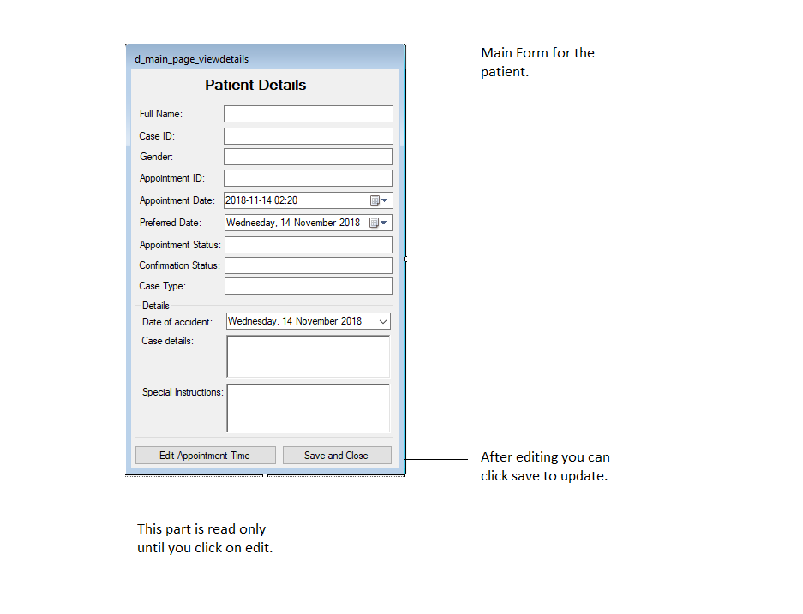
Login as a Patient

Slide 5
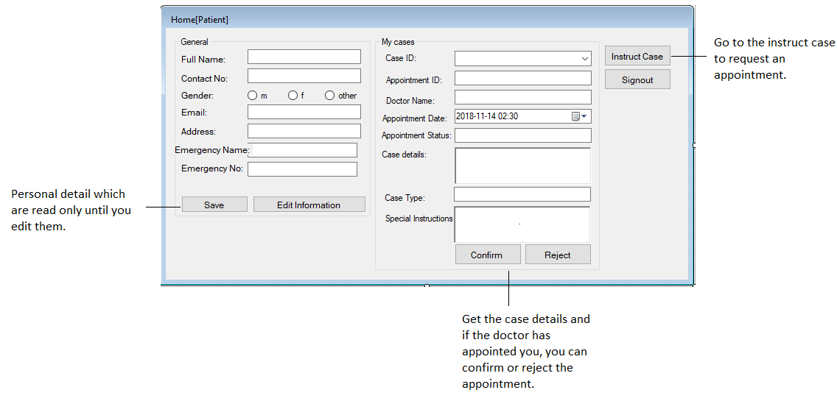
Login as Patient

Slide 6
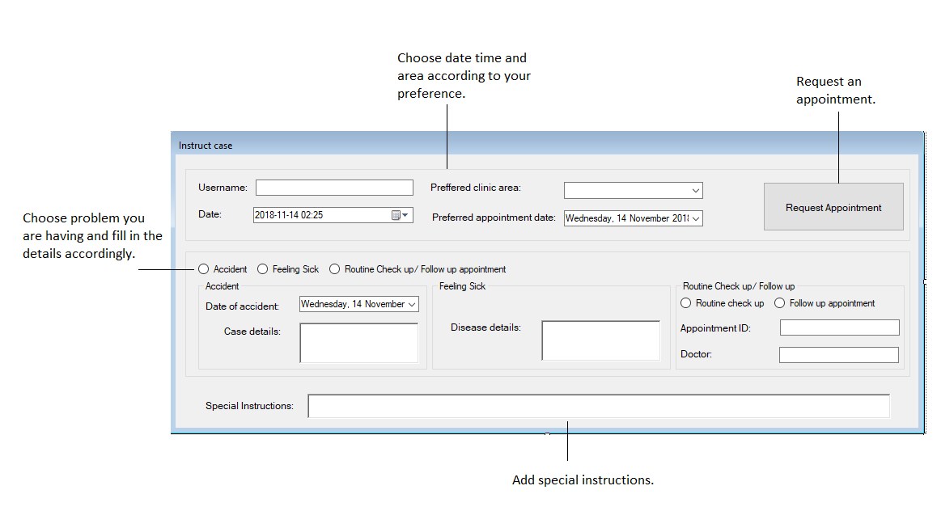
Instruct a case

Slide 7
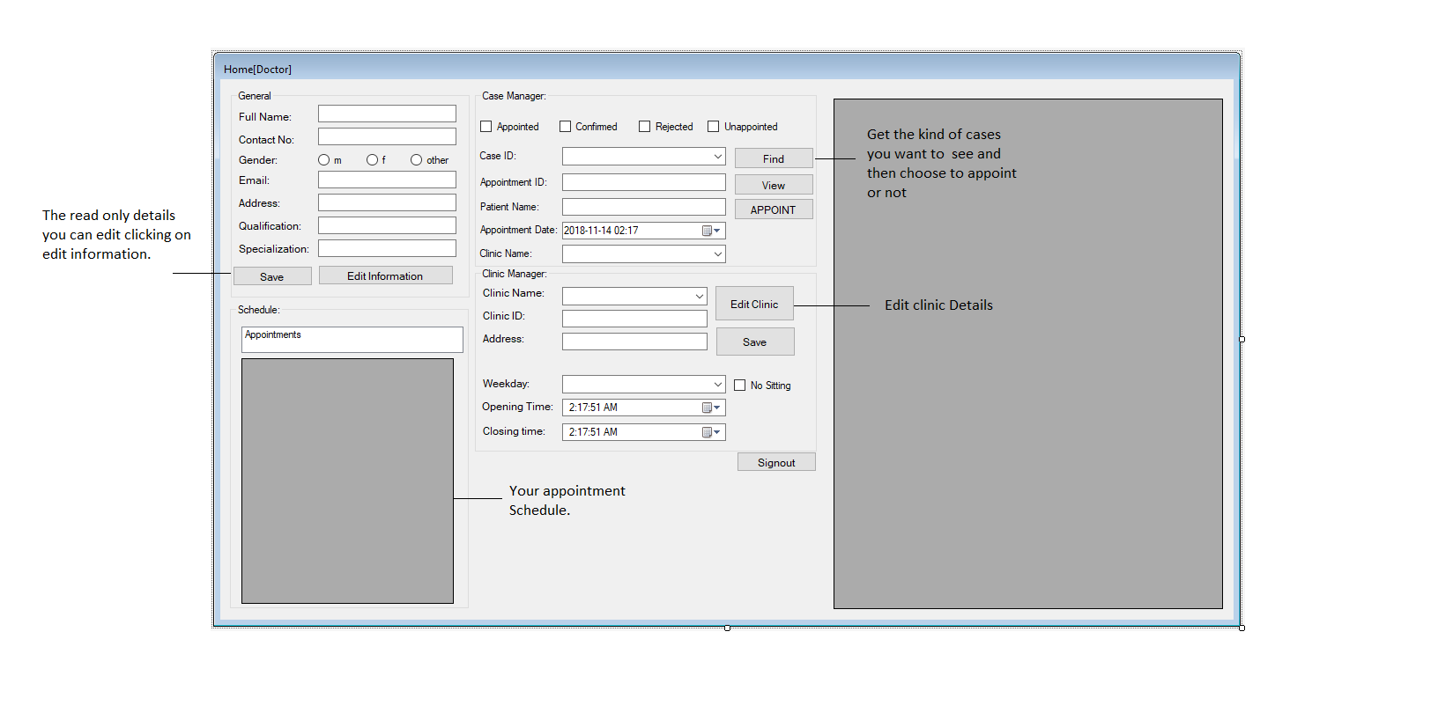
Login as Doctor

Slide 8
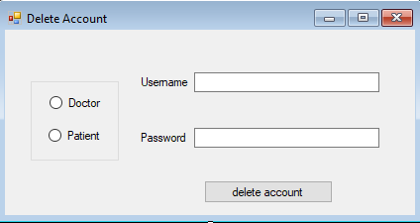
Delete page

